Slide 1

Housing Choice Vouchers: Correlates of Change
Brian A. Mikelbank, Associate Professor
Levin College of Urban Affairs
Cleveland State University
Matthew Martin Thomas, MS Urban Studies
Housing Assistant
Detroit Shoreway Community Development Organization
CLE Housing Hackathon
7 May 2017

Slide 2
Outline
Brief background and Context
Population, Housing, HCVP
HCV Change, 2000-2010
Methods
Findings

Slide 5
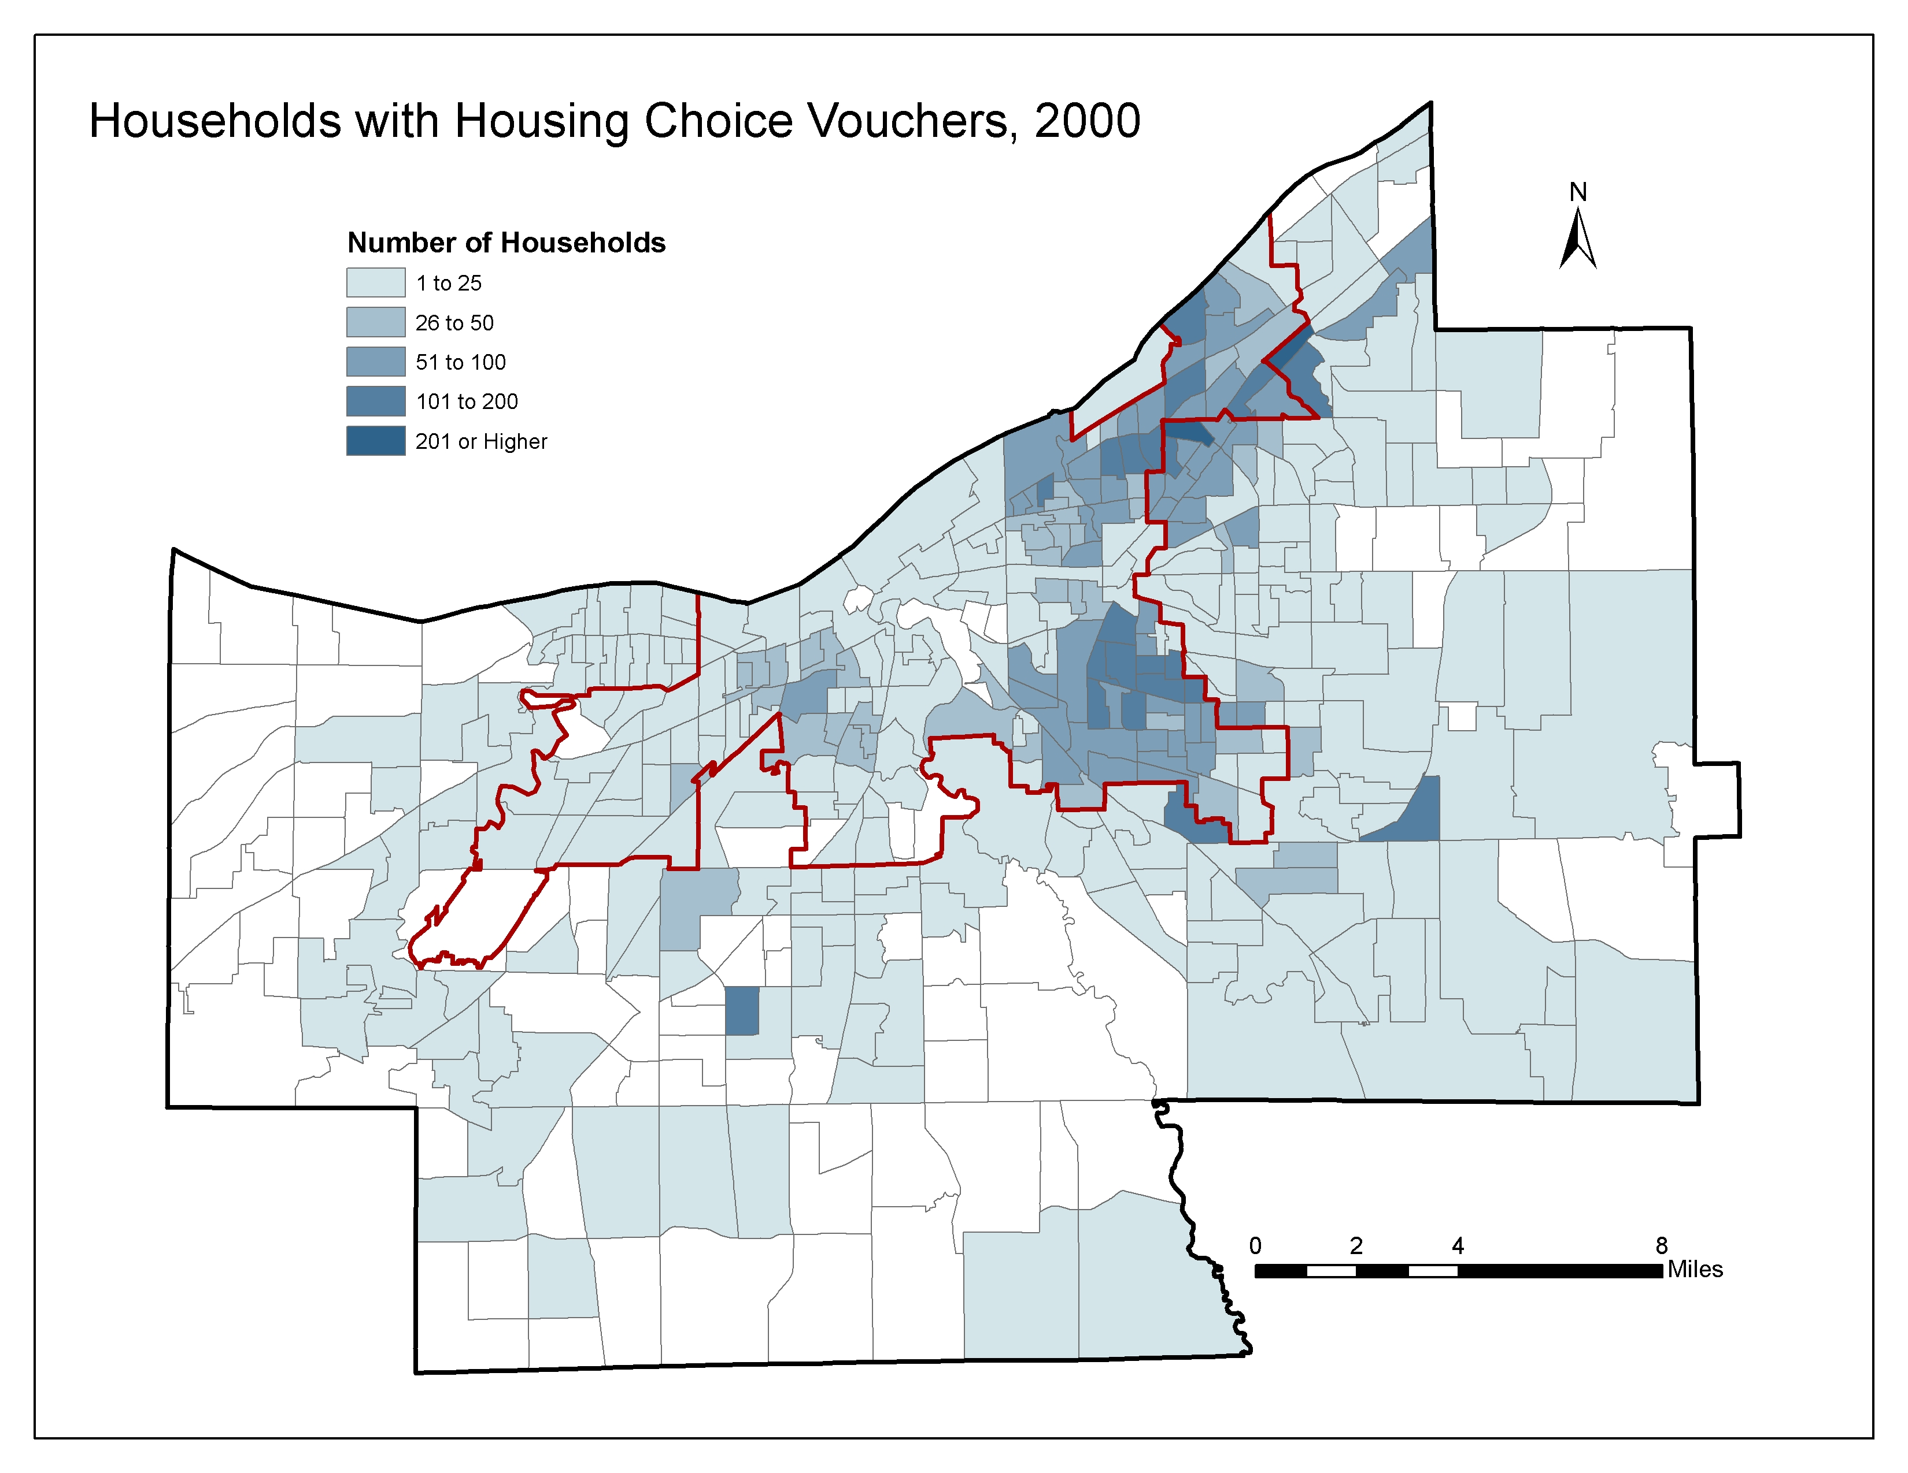

Slide 6
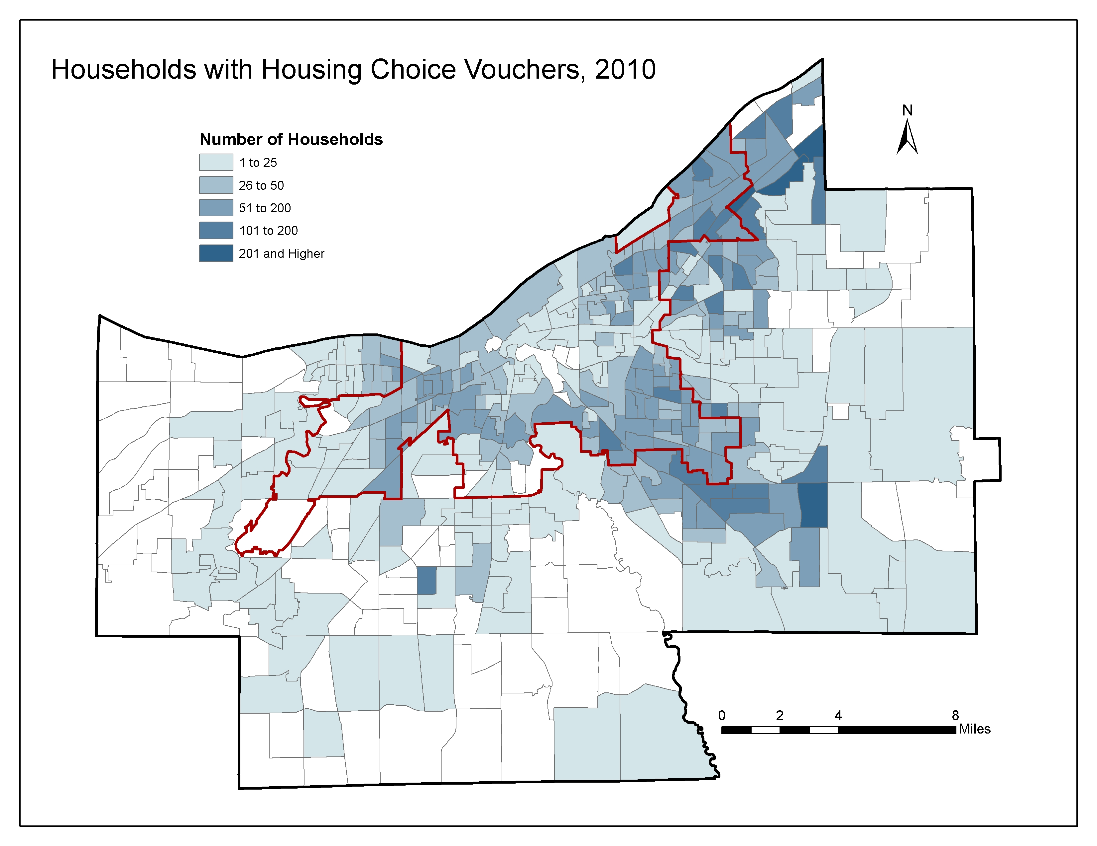

Slide 7
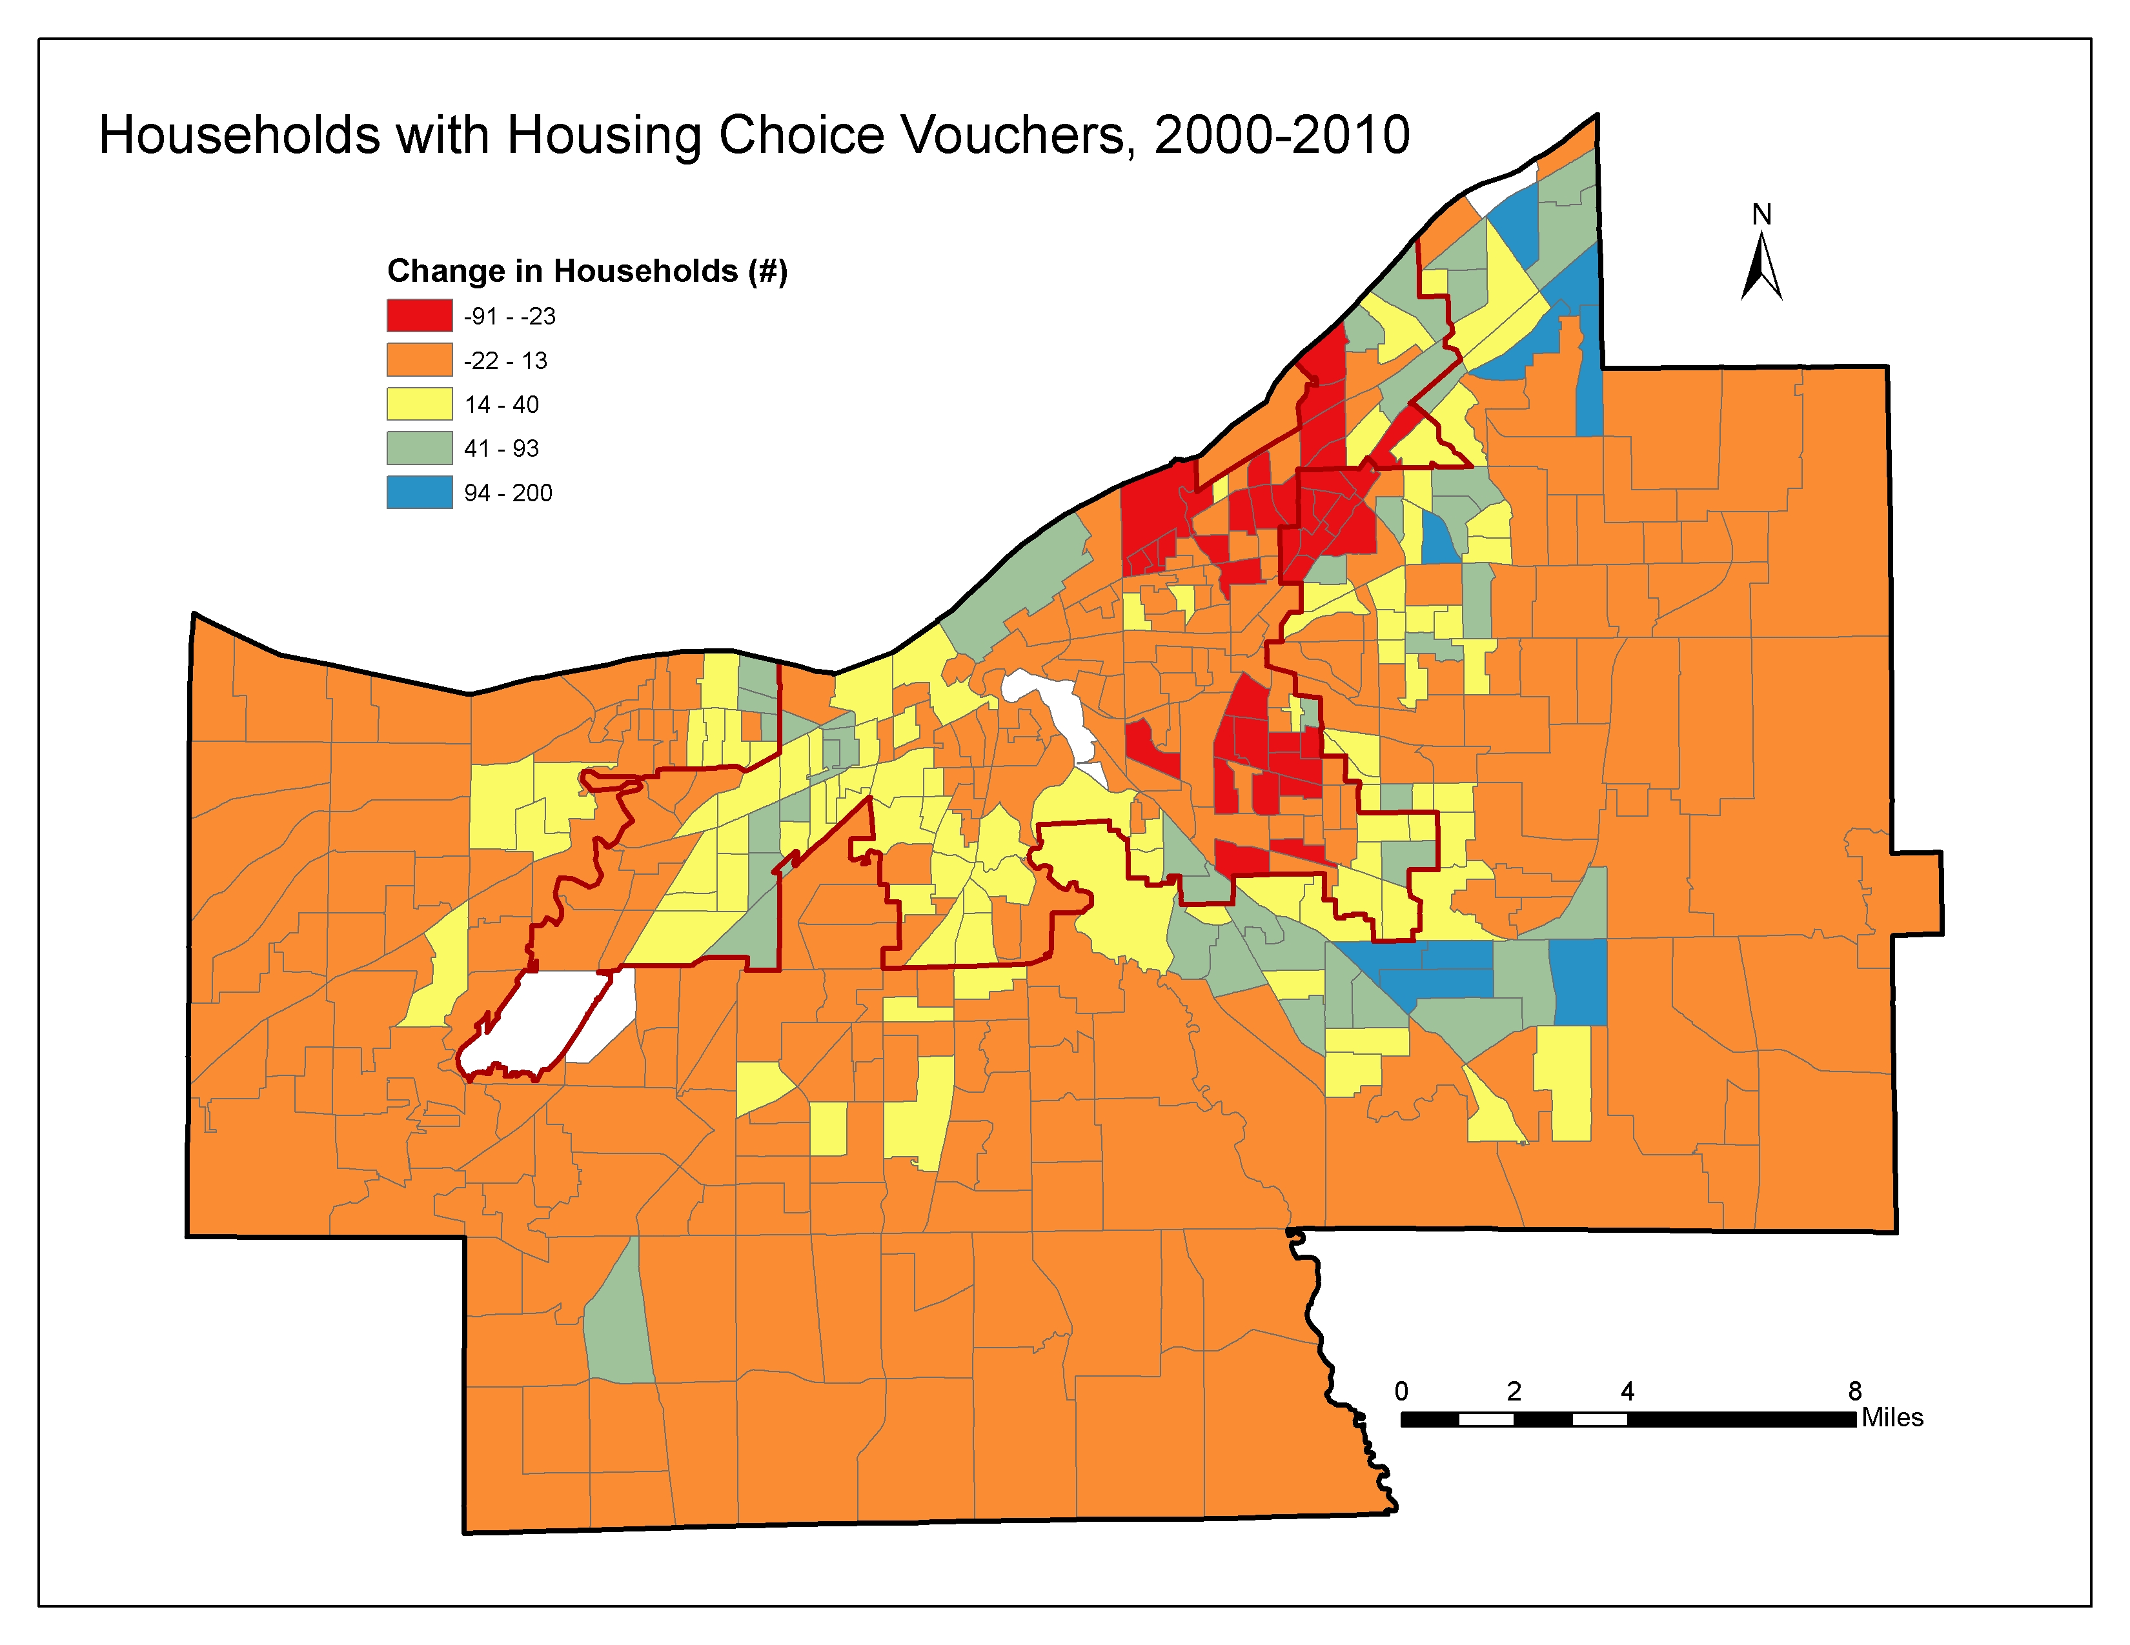

Slide 8

Shift-Share
Decomposes regional change over time into separate and unique factors over spatially distinct geographies
Typically, Regional Economic Change
1) National Growth Effect
2) Industry Mix Effect
3) Regional Competitive Effect
$${tg}_{i}={e_{i}}_{}^{t}{×(G}^{t→t+n}){{+e}_{i}}_{}^{t}{{{×(G}_{i}}^{t→t+n}−G^{t→t+n})+e_{i}}_{}^{t}{×(g_{i}}^{t→t+n}−{G_{i}}^{t→t+n})$$

Slide 9
Shift-Share Analysis and Housing
County Housing Growth Effect
2) Housing Mix Effect
3) Local Competitive Housing Effect
“Sectors” of housing market
Owner-occupied units
Market rental units
Subsidized rental units (HCV)
Vacant units
Unit of analysis: census tract
Reference region: Cuyahoga county

Slide 11
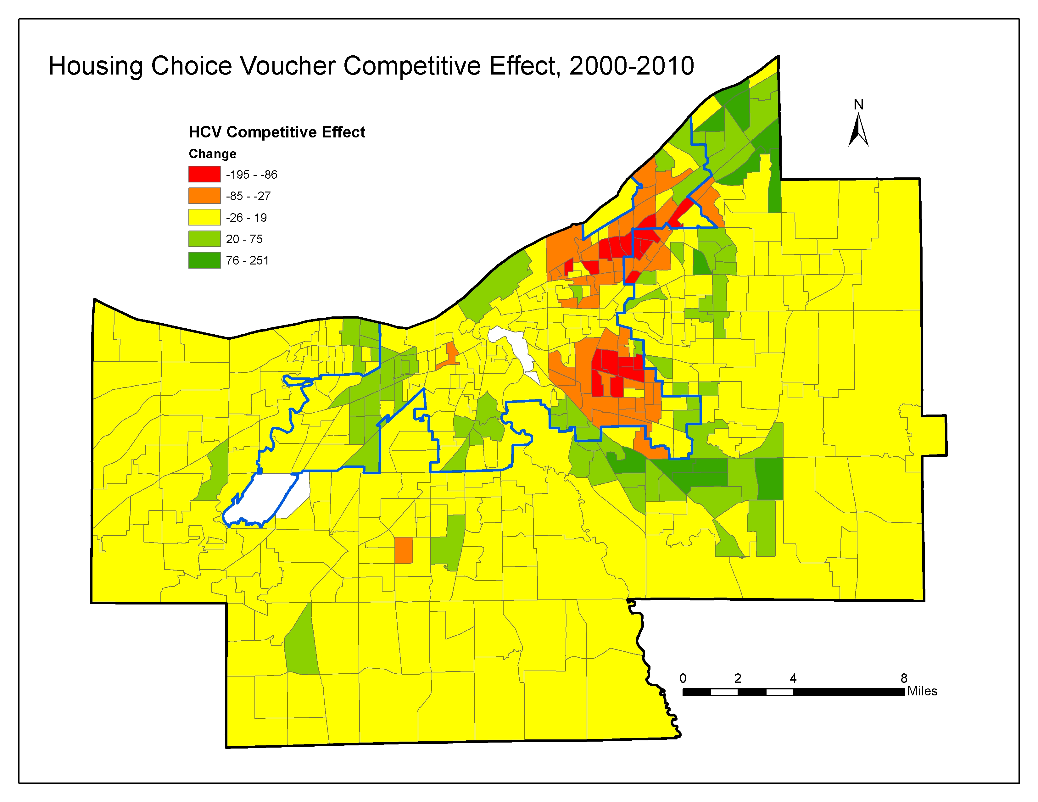

Slide 12
Research Question
What are the correlates of HCVP change* in Cuyahoga County between 2000 and 2010?

Slide 13
Regression
Explain the variation in the “Competitive effect” of HCV change between 2000 and 2010
Explanatory variables:
Neighborhood characteristics and change
Neighborhood structural characteristics
Neighborhood (Dis)amenities
Unit of Analysis: Census Tract

Slide 15
Results
Well, no kidding
That’s kind of interesting
Oh, that’s concerning

Slide 16
Well, no kidding
2000-2010 HCVP growth* associated with:
Below average growth in:
Rent
Household income
Above average growth in:
Sheriff sales
Multi-unit structures (20+u)

Slide 17
That’s kind of interesting
2000-2010 HCVP growth* negatively associated with:
2000 voucher levels
2000-2010 HCVP growth* not significantly associated with:
Poverty rates
Percent minority population

Slide 18
Oh, that’s concerning
2000-2010 HCVP growth* not significantly associated with:
HUD’s Jobs proximity index
HUD’s School proficiency index
HUD’s Environmental health hazard index
USDA’s food access indicator
2000-2010 HCVP growth* negatively associated with:
HUD’s Low Transportation Cost Index

Slide 19
Summary
Well, no kidding
Weak housing market neighborhoods
That’s kind of interesting
Different than previous weak housing market neighborhoods
Less poverty and minority concentration
Oh, that’s concerning
But not necessarily more opportunity

Slide 20
Housing Choice Vouchers: Correlates of Change
Brian A. Mikelbank, Associate Professor
Levin College of Urban Affairs
Cleveland State University
Matthew Martin Thomas, MS Urban Studies
Housing Assistant
Detroit Shoreway Community Development Organization
CLE Housing Hackathon
7 May 2017

